Slide 1
GET READY FOR A CRUDE & PAINFUL HAIRCUT
THE CONSEQUENCE OF ECONOMIC MISMANAGEMENT
PRESENTATION BY:
DR. CASSIEL ATO FORSON, MP
RANKING MEMBER, FINANCE COMMITTEE

Slide 2
WHERE WE HAVE COME FROM
The Akuffo-Addo/Bawumia Government inherited a total public debt of about GHS120 billion representing 55.6% of GDP as at end 2016
Today, the world bank has projected Ghana’s public debt to hit 104.7% of GDP by end 2022 which means that our actual public debt by end 2022 will be about GHS522 billion
2

Slide 3
WHERE WE HAVE COME FROM
In nominal terms, within 6 years in office the Akuffo-Addo/Bawumia government would have accumulated about GHS402 billion fresh debt by Dec. 2022
This means that within 6yrs in office the Akuffo-Addo/Bawumia government has accumulated the equivalent of 50% of today’s GDP in fresh debt
3

Slide 4
EXTERNAL & DOMESTIC DEBT
UNSUSTAINABLE DEBT LEVEL
Ghana’s Total Public Debt has increased from GH¢120 bn at end 2016 to GH¢393 bn as at June 2022
)
4

Slide 5
INTRODUCTION
This means the NPP administration has been responsible for about 80% of Ghana’s total public debt since Kwame Nkrumah, in only 6yrs, with very little to show.
This government has successfully driven our dear country into the ditch by making our debt highly unsustainable to a point of no return.
5

Slide 6
INTRODUCTION
Ghana has been made poorer under this administration. COCOBOD has accumulated over GH¢14 billion in cocoa bills (loans), ECG owes IPPs over GH¢12 billion, almost every single State Owned-Enterprise is insolvent. The situation is scary and worrying.
Currently, the gov’t owes contractors and suppliers about GHS100billion. The following shows some of the debt owed by various State Entities.
6

Slide 7
GH¢70
GH¢3
GH¢2
GH¢10
GH¢3
BILLION
BILLION
BILLION
BILLION
BILLION
+
+
+
+
+
Waiting for payment at the ministry of finance (contractors & suppliers)
GETFund
Road Fund
Various
MMDAs
COCOBOD
7
5

Slide 8
INTRODUCTION
Ghana will need to take a very bitter pill to address this cancer of national embarrassment and undeserving albatross arising from economic mismanagement
If this administration had heeded the wise counsel from the NDC, some civil society organizations (CSOs) and well-meaning Ghanaians, we wouldn’t be here
8

Slide 9
INTRODUCTION
This ineptitude and intransigence has occasioned loss of confidence in the Ghanaian economy by the investor community
Businesses are moving from Ghana to Ivory Coast and other neighboring countries, companies are shutting down and lay-offs are becoming a daily routine with frequent and devastating downgrades by rating agencies
9

Slide 10
CREDIT RATING
The Spread (interest rates) of Ghana’s sovereign bonds have widened significantly in the International Capital and Domestic Market
This year alone, as a result of our deteriorating economic condition, Rating Agencies have downgraded Ghana’s credit worthiness in an unprecedented manner;
Fitch from B- to CC with Outlook under Review;
Standard and Poor’s from B- to CCC+ with a Negative Outlook; and
Moody’s from B3 to Caa2 with Outlook under Review
10

Slide 11
CREDIT RATING
Our unsustainable debt levels have led rating agencies to describe Ghana as a country where debt default is imminent with very little prospect for recovery
These rating agencies are likely to downgrade Ghana further to D in the coming months because of an obvious and pending debt restructuring
11

Slide 12
THE PUBLIC DEBT BURDEN IS THE MAIN PROBLEM
Excessive Borrowing leading to Huge Public Debt Overhang and the loss of access to the International Capital Market is the Elephant in the Room.
Ghana’s public debt overhang has reached an unprecedented level, and is trending upwards.
Even though, public debt levels have risen across some countries, the capacity to live with such debt levels varies considerably from country to country; the ability to repay is not the same
12

Slide 13
THE PUBLIC DEBT BURDEN IS THE MAIN PROBLEM
The Akufo-Addo/Bawumia Government refuses to accept that, Ghana’s economic woes are deeply rooted in its accumulation of public debt to an unsustainable level.
The following analysis confirms that Ghana’s unsustainable debt is the problem.
13

Slide 14
GHANA’S DOMESTIC DEBT AS A % TO DOMESTIC REVENUE
Ghana’s Total Domestic Debt as at end December 2020 had increased to 278% of domestic revenue, almost three times the size of Domestic Revenue and is expected to worsen by the end of 2022
This situation now is far worse than the HIPC era
14

Slide 15
GHANA’S DEBT SERVICE AS A % TO DOMESTIC REVENUE
At the end of December 2016, 51.2% of Ghana’s Domestic Revenue was used to service our Total Public Debt
It increased to 71.7% at the end of December 2020; (excluding hidden debt such as, energy bond, GETFund Daakye bond and Synohydro loan, etc.)
This is expected to worsen by end of 2022, even beyond the HIPC days
15

Slide 16
GHANA’S INTEREST PAYMENT AS A % DOMESTIC REVENUE
Interest Payment was 36.6% of Domestic Revenue as at the end of December 2016
At the end of December 2020, about 46% of Ghana’s Total Domestic Revenue was used for Interest payment
By end of 2022, Ghana will use over 50% of it’s entire domestic revenue to service interest on the public debt
16

Slide 17
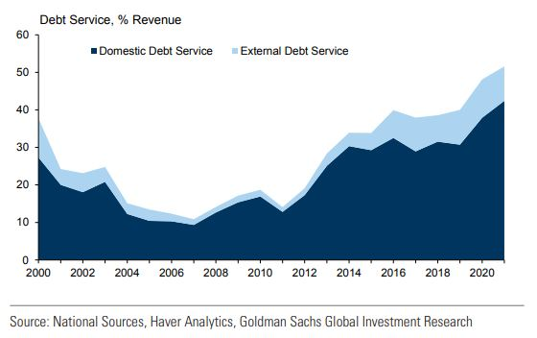
GHANA’S INTEREST PAYMENT AS A % DOMESTIC REVENUE
17
Nearly 50% of Domestic Revenue goes towards debt Servicing, crowding out critical expenditure as at end 2020
By end of 2022, Ghana will use over 50% of it’s entire domestic revenue to service debt making it worse than the HIPC era

Slide 18
GHANA’S DEBT SERVICE AS A % TO TAX REVENUE
At the end of December 2016 Ghana’s debt service was about 66% of its Tax revenue
The ratio increased sharply to 73% by December 2019 and further deteriorated to 87% by December 2020 and rose to 92% in 2021
It is expected to worsen further to about 95% of tax revenue by end of 2022
18

Slide 19
GHANA’S INTEREST PAYMENT AS A % OF TAX REVENUE RATIO
18
Interest Payment as a % of tax revenue increased to 55% at the end of December 2020
And it is expected to worsen by the end of December 2022

Slide 20
GOVT’S RECKLESS FISCAL BEHAVIOUR AND CREATIVE ACCOUNTING IS THE REASON FOR DEBT OVERHANG
The debt level is the main problem, but it should be noted that gov’t reckless fiscal behavior and creative accounting is the reason for this huge debt level
The rise in debt service cost has mostly been due to huge fiscal deficits and large budget financing needs since 2018, when the fiscal indiscipline started
As a result of reckless borrowing and government policy of “one problem. one loan(1P1L)”, debt service cost is now exceeding 8% of GDP
20

Slide 21
GOVT’S RECKLESS FISCAL BEHAVIOUR AND CREATIVE ACCOUNTING IS THE REASON FOR DEBT OVERHANG
The rising debt service cost has crowded out most critical expenditures, such as education and health
Ghana has reached a point where about 90% of our tax revenue is used to service debt making it virtually impossible to pay for statutory funds from the same tax revenue
21

Slide 22
GOVT’S RECKLESS FISCAL BEHAVIOUR AND CREATIVE ACCOUNTING IS THE REASON FOR DEBT OVERHANG
Item(GHC) | 2018 | 2019 | 2020 | 2021
Deficit | -11,672,748,535 | -16,891,843,383 | -44,920,535,911 | -42,354,660,871
% of GDP | -3.9 | -4.8 | -11.7 | -9.2
Deficit (Inc. financial and energy sector payments) | -21,474,029,169 | -25,235,165,439 | -59,120,535,911 | -52,200,821,106
% of GDP | -7.1 | -7.1 | -15.1 | -11.4
o/w Financial Sector Payments | 9,801,280,634 | 3,198,719,366 | 8,000,000,000 | 2,953,848,070
o/w Energy Sector Payments | 0 | 5,144,602,690 | 6,200,000,000 | 6892312164
Deficit (Inc. financial and energy sector payments, and arrears) |  | -25,235,165,439 | -67,320,535,911 | -56,903,909,827
% of GDP | -7.1 | -7.1 | -17.2 | -12. 4
Financing | 21,474,029,169 | 25,235,165,439 | 67,320,535,911 | 56,903,909,827
% of GDP | 7.0 | 7.1 | 17.2 | -12.4
Nominal GDP | 308,587,395,726 | 356,544,265,615 | 391,940,733,197 | 459,130,921,540
22

Slide 23
GHANA’S ABILITY (OR RATHER INABILITY) TO REPAY ITS DEBT
There is the need to examine Ghana’s ability or rather inability to repay its debt
In the first six months of 2022, i.e., Jan. – Jun 2022, Ghana’s total tax revenue was GHS30 billion
During the same period debt service obligation was GHS26.1 billion, representing 87% of tax revenue. Leaving only GHS3.9 billion to run the entire nation for the period
23

Slide 24
GHANA’S ABILITY (OR RATHER INABILITY) TO REPAY ITS DEBT
Government spent GHS17 billion on compensation of employees (wages & salaries) alone, for the same period. This means that the government borrowed to pay for wages & salaries between Jan and June of 2022
Ghana’s half year total tax revenue of GHS30 billion (Jan-Jun 2022) was certainly not enough to pay for our debt service obligation and wages & salaries amounting to GHS43.1 billion(GHS26.1b+GHS17b)
24

Slide 25
GHANA’S ABILITY (OR RATHER INABILITY) TO REPAY ITS DEBT
This is largely because of the huge debt service obligation as a result of reckless borrowing
It should be noted that, out of the GHS30 billion tax revenue, GHS10 billion is earmarked for statutory funds such as DACF, NHIL, GETFund, RoadFund and this means they were not be paid
25

Slide 26
GHANA’S ABILITY (OR RATHER INABILITY) TO REPAY ITS DEBT
26

Slide 27
GHANA’S ABILITY (OR RATHER INABILITY) TO REPAY ITS DEBT
27

Slide 28
GHANA’S ABILITY (OR RATHER INABILITY) TO REPAY ITS DEBT
27

Slide 29
GHANA’S ABILITY (OR RATHER INABILITY) TO REPAY ITS DEBT.
Ghana has inevitably reached a point where the interests of creditors and the public have collided
Creditors, including T-bills holders, bondholders, term loan holders, gov’t contractors, etc. definitely want to be repaid according to the terms of their finance agreement or contract
On the other hand, the public wants public pension to be paid, healthcare to be provided, roads to be maintained, children to be educated
29

Slide 30
GHANA’S ABILITY (OR RATHER INABILITY) TO REPAY ITS DEBT.
The truth is, Ghana cannot currently afford to repay its debt according to the finance agreement and provide public goods at the same time.
Ghana is simply insolvent in other words bankrupt
30

Slide 31
THE PROBLEM IS INSOLVENCY NOT LIQUIDITY (Yen tu me ntua NOT Yentua)
A clear cut distinction between solvency and liquidity is possible since borrowing cost and market access depends on solvency.
Ghana is currently suffering from Sovereign Insolvency Stress (SIS) which means we are facing the following
Loss of market access
High/Rising borrowing cost
Rapid depreciation of the Ghanaian cedi
High inflation
Default
Low fiscal space
31

Slide 32
THE PROBLEM IS INSOLVENCY NOT LIQUIDITY (Yen tu me ntua NOT Yentua)
Our debt situation has been unsustainable since 2021; Ghana is currently insolvent or bankrupt and cannot repay it’s debt. The problem is NOT liquidity
32

Slide 33
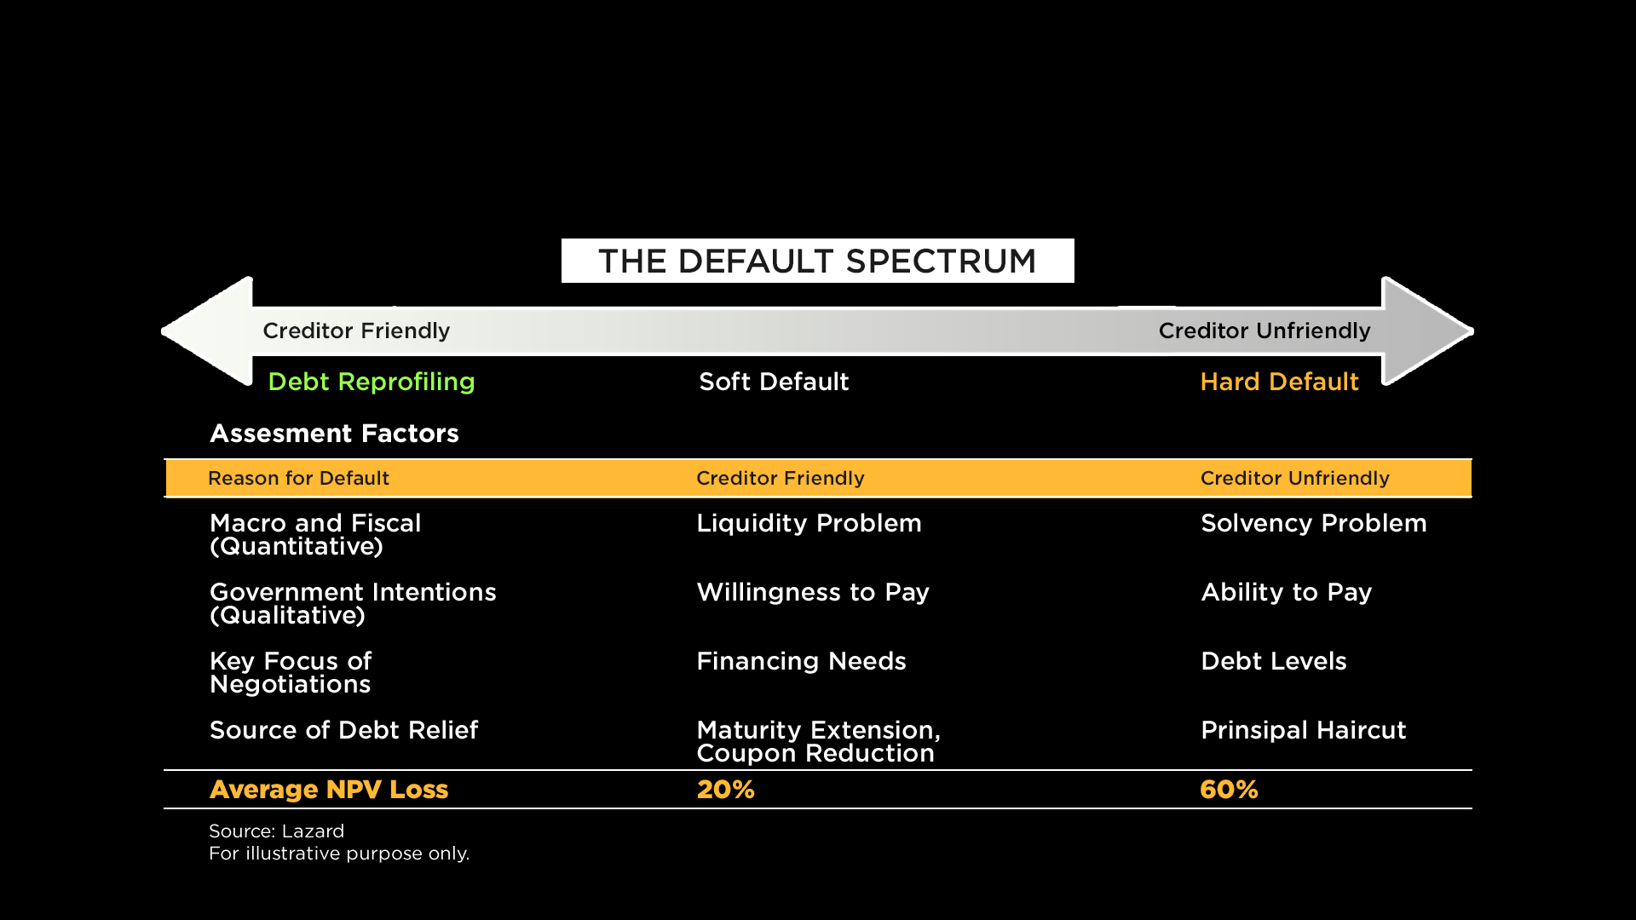
THE PROBLEM IS INSOLVENCY NOT LIQUIDITY (Yen tu me ntua NOT Yentua )
33

Slide 34
HOW COUNTRIES DEAL WITH UNSUSTAINABLE DEBT
Ghana’s rising debt burden confronts our government with difficult choices, especially as our debt distress trend is upward.
The government will have to deliver 8% of GDP primary surpluses 4 consecutive years to lower debt-GDP from 100% to 70%. If gov’t decide to repay it through fiscal adjustment
34

Slide 35
HOW COUNTRIES DEAL WITH UNSUSTAINABLE DEBT
There are typically five ways to deal with unsustainable public debt:
grow out of it
inflate it away
evade it through financial repression(yen ntua)
repay it through fiscal adjustment
restructure it (yen tu me ntua)
35

Slide 36
DEALING WITH GHANA’S UNSUSTAINABLE DEBT THROUGH FISCAL ADJUSTMENT
This will mean a fiscal adjustment of about 8% of GDP (taxes & expenditure cuts)
Additional taxes will be too painful and increase suffering for the people of Ghana and can not be an option
36

Slide 37
DEALING WITH GHANA’S UNSUSTAINABLE DEBT THROUGH FISCAL ADJUSTMENT
These measures may be punitive and lead to socio-political instability, obviously because of the current economic hardship
If the government had listened to us in 2021, Ghana could have remedied the situation but unfortunately they refused to act and the fiscal crises has escalated
37

Slide 38
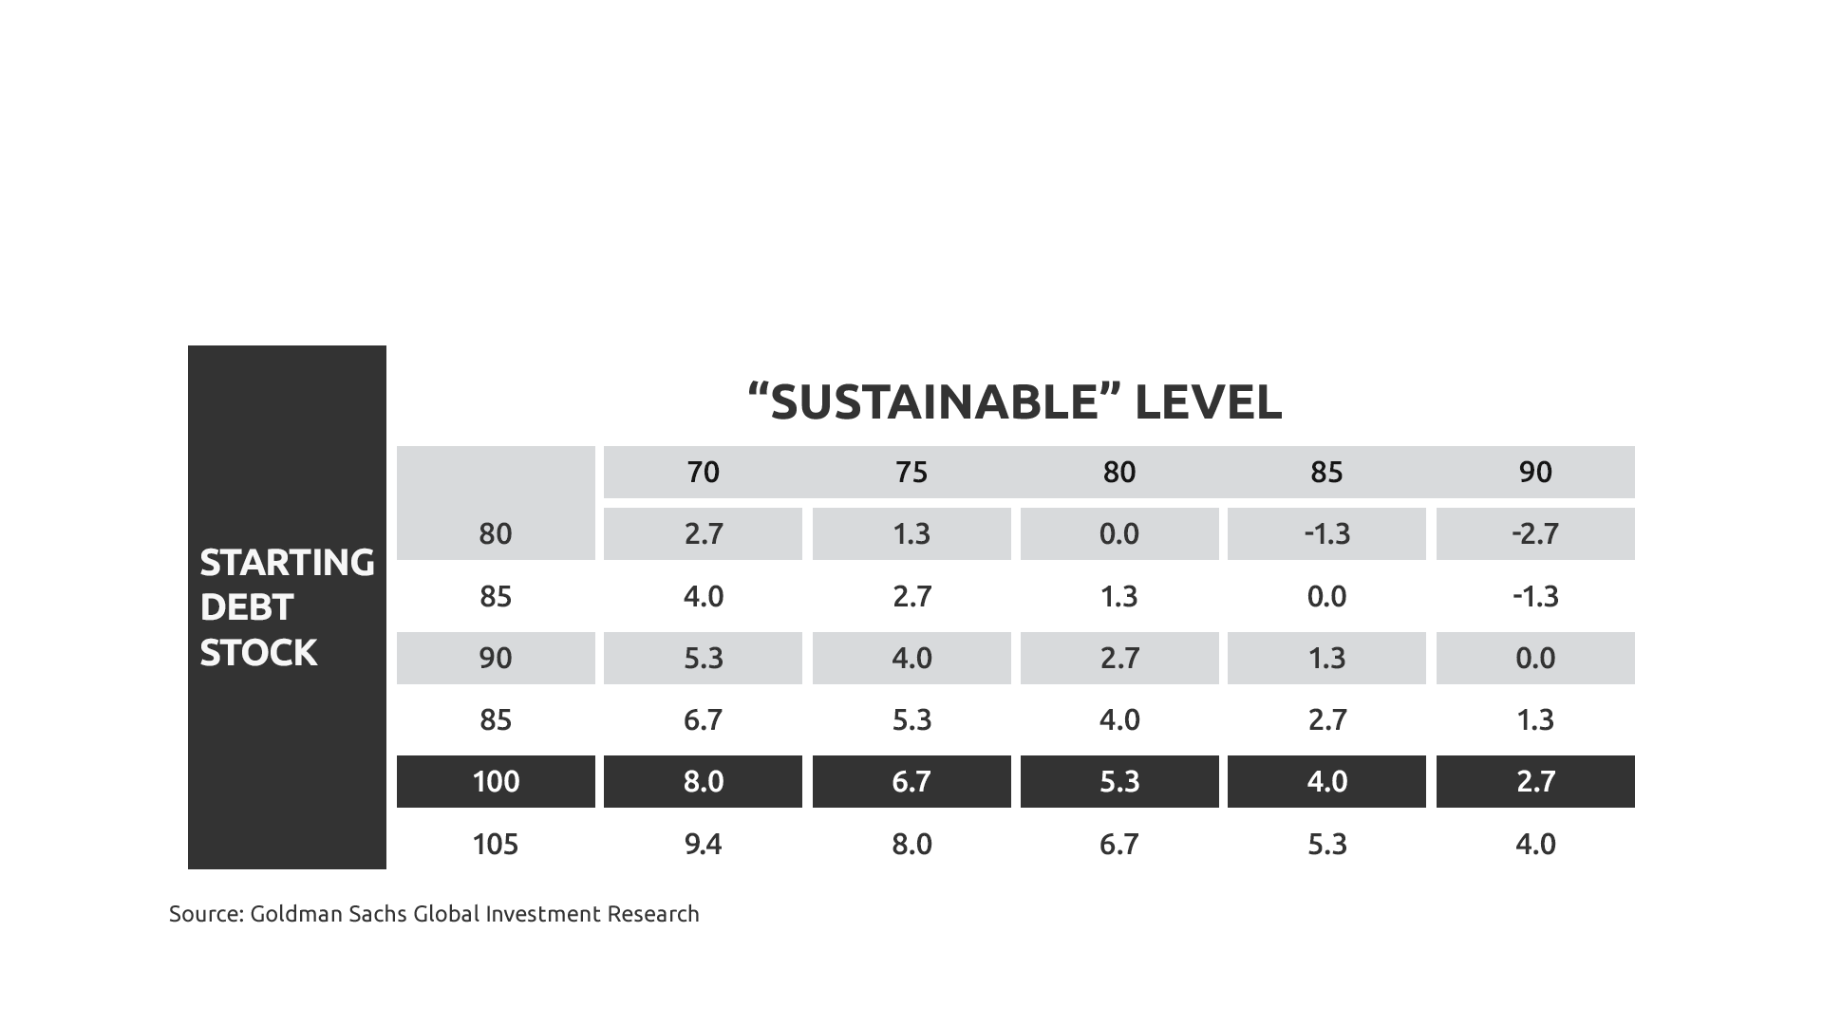
DEALING WITH GHANA’S UNSUSTAINABLE DEBT THROUGH FISCAL ADJUSTMENT
Primary Surplus of 8.0% of GDP Would be Required to Lower Debt/GDP to 70% Over 4yrs
38

Slide 39
DEALING WITH GHANA’S UNSUSTAINABLE DEBT THROUGH DEBT RESTRUCTURING
Government has started talking about debt restructuring as a tool to deal with the unsustainable debt levels
Debt restructuring simply means Ghana cannot meet its debt service obligation (yen tu me ntua) and has to re-negotiate payment terms
39

Slide 40
DEALING WITH GHANA’S UNSUSTAINABLE DEBT THROUGH DEBT RESTRUCTURING
The announcement of debt restructuring will mean that Ghana has defaulted in it debt service obligation and will have to re-negotiate.
International credit rating agencies are most likely to downgrade Ghana to D in the coming months as soon as government officially announces debt restructuring.
The process of Debt Restructuring is similar to the HIPC program. However, the HIPC targeted bilateral and multilateral loans, debt restructuring will target commercial loans.
40

Slide 41
DEBT RESTRUCTURING-CONT’D
Examples of Commercial lenders and possible restructure envelope may include
Domestic bondholders
GETFund Daakye bondholders
Foreign bondholders
Cocoa bills bond holders
Term loans from local banks
Bilateral loans
Term loans from foreign banks
Export credit loans
41
ESLA bondholders
Gov’t contractors and suppliers

Slide 42
DEBT RESTRUCTURING-CONT’D
Commercial Lenders and others will have to accept a reduction in interest and principal payment or risk default and non-payment
42

Slide 43
Debt Restructuring Methods and Techniques
There are three(3) main method in debt restructuring.
Change the maturity date(maturity extension) for amount of Principal or Interest falling due under the affected debts and Introduce Grace Periods.
Reduce the Principal Amounts of the debt, (a Principal Hair-cut)
Reduce the Interest Rate on the debt for bond indebtedness (coupon adjustment)
43

Slide 44
Debt Restructuring Methods and Techniques
It is possible to mix and match the three methods above, e.g. maturity extension with a coupon adjustment
Debt restructuring is not a science but an art and can be tailored to suit a particular debt crises such as Ghana’s problem
44

Slide 45
Debt Restructuring Methods and Techniques
Creditors can be expected to express strong views about the method chosen to address the sovereign debt problem.
Principal haircuts are unfriendly to creditors
maturity extension and coupon reduction are creditor friendly
45

Slide 46
Domestic versus External Debt Restructuring
One of the biggest dilemmas in sovereign debt restructuring is the extent to which the burden should be borne by holders of debt instruments governed by domestic and foreign laws; Domestic Debt versus External Debt
Restructuring domestic debt is like surgery, you only do it, if you must, and you avoid it, if it might do more harm than good
46

Slide 47
Domestic versus External Debt Restructuring
Domestic debt restructuring is a tool that can be used by countries facing fiscal and economic insolvency stress
A sovereign nation such as Ghana with a strong desire to maintain access to external capital market, may have an incentive to restructure only domestic debt but it will come at a serious cost
47

Slide 48
Domestic versus External Debt Restructuring
Restructuring local debt must be thought through well. Imagine the consequences of haircuts on face value and interest rates of your bond:
Imagine waking up one day only to be told that your GHS1 million in government bond has suddenly become GHS700k
48

Slide 49
Domestic versus External Debt Restructuring
Imagine your 25% interest on your investment suddenly becoming 15% at the time inflation is almost 40%
Imagine an individual loosing so much of his lifetime savings, that has been invested in government bonds and the so called risk free
49

Slide 50
Domestic versus External Debt Restructuring
Pension funds will suffer a drop in value. Tier 2 and 3 pension payouts will drop from already low levels
Tier 1 (SSNIT) reserves will drop in value. SSNIT capacity to pay will suffer
Insurance company reserves will fall with implications for benefit payments
50

Slide 51
Domestic versus External Debt Restructuring
Banks and other deposit taking institutions (savings and loans, rural banks, credit unions) will suffer because they hold their reserves in local bonds
Restructuring domestic debts may undermine the health of the banking system since Capital adequacy will become a challenge
Lots of trouble looming on the horizon (get ready)
51

Slide 52
Holders of Domestic Bonds
52

Slide 53
How to Restructure Sovereign Debt
The Restructuring Envelope
Ghana has already engaged the services of a financial and legal advisor. Therefore, the process is far advanced, debt restructuring is coming with speed
The advisors, together with the IMF will determine the overall quantum of debt relief needed, - the Restructuring Envelope
An IMF/WB Debt Sustainability Analysis (DSA) will help inform the creditors about the capability of Ghana to pay
53

Slide 54
How to Restructure Sovereign Debt
We estimate that, Ghana will require a debt relief of above 45% of GDP, in excess of about GHS200billion to make our debt sustainable
To make our debt sustainable we will need to reduce our debt-to-GDP from over 100% to about 55%
54

Slide 55
CONSEQUENCES OF DEBT RESTRUCTURING
Ghana will be the first Sub-Saharan African country to restructure its commercial debt with huge reputational damage
From a Heavily Indebted Poor Country(HIPC) to Sovereign Insolvency Stress (SIS) all within 20yrs.
Economic growth in the next 3yrs will be the biggest casualty
55

Slide 56
RECOMMENDATIONS
The future of our dear country is at stake and there is the need not to leave our future and livelihood only to the ruling government, we all have to get involved
We cannot sit unconcerned and wait for IMF to save our dear country. There are economic tools that can be deployed to save our country from collapse
The minority recommend a set of policy options for government and demand urgent consideration.
56

Slide 57
RECOMMENDATIONS
Curbing inflation should be the top priority: Ghana does not want inflation to be entrenched, we need to confront inflation now before it becomes too late.
The Bank of Ghana needs to anchor inflation expectation immediately. They should stop the printing of money otherwise knowns as monetary financing to finance government expenditure.
57

Slide 58
RECOMMENDATIONS
To stem the rapid depreciation of our cedi the Bank of Ghana may have to call for an emergency monetary policy committee meeting and consider the need to hike the monetary policy rate, even if it is for purposes of signaling that somebody is in charge
Government must prioritize and rationalize expenditure by cutting all unnecessary and frivolous expenditures imposing taxes at this time will hurt Ghanaians and undermine economic growth and recovery. However, there is an urgent need to improve compliance in tax collection
58

Slide 59
RECOMMENDATIONS
There is an urgent need to support the poor and the vulnerable in our society since the economic hardship is affecting them the most
It is unfortunate but it looks like the time has come for the Bank of Ghana to implement emergency foreign currency management by introducing the infamous Capital Flow Management (CFM) measures.
59

Slide 60
CONCLUSION
The haircut will hit you directly or indirectly. It doesn’t matter if you have no hair. It will be crude and extremely painful
Don’t celebrate if you are bald headed like me, the crude haircut will still find you
Mr. President, please beware that, a micky mouse form of debt restructuring will hurt Ghana BIG TIME. Your debt restructuring must not target domestic creditors. It will destroy us
60

Slide 61
CONCLUSION
Ghana is in a deep mess because the managers of the economy failed to act.
For them everything is about the next elections, they never accept responsibility. They always say “it wasn’t me, it was the guy behind the tree”
They live on another planet, don't appreciate what the IMF will require from them let alone start action. The ineptitude is unbelievable
61

Slide 62
CONCLUSION
The Ghanaian economy is suffering from Sovereign Insolvency Stress and Stagflation Coupled with Acute Debt Overhang Syndrome (SIS-SADOSES)
Honestly, we are in a BIG MESS.
62

Slide 63
CONCLUSION
If the economic hardship and the haircut hit you, remember it is as a result of the ineptitude of Alhaji Bawumia and his Economic Management Team
A Chinese proverbs says: He who blames others has a long way to go on his journey. He who blames himself is halfway there. He who blames no one has arrived.
62

Slide 64
THANK YOU

